Slide 1

Tissue classification in primary colorectal tumors
YANG, Yingxi
WONG, Kwan Long
HUANG, Hanli

Slide 2
Contents
Introduction
Data
Methodology
Results
Part 1: Generative results of tumor or stroma samples
Part 2: Classification results with deep learning
Conclusion

Slide 3

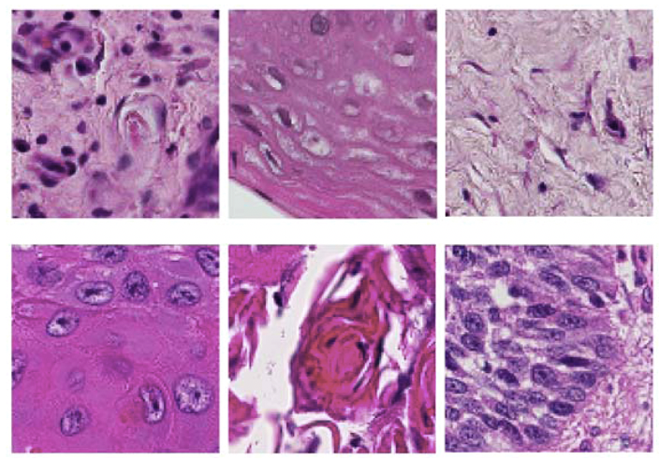
Introduction - Background
Cancer is one of the deadliest diseases in the world
Histological analysis can reveal crucial information about tumor architecture
Understanding the tissue types of primary colorectal tumors is essential
Tumor progression
Patient prognostication
Choosing appropriate treatment
Manual evaluation of histological images is time-consuming and expensive

Slide 4
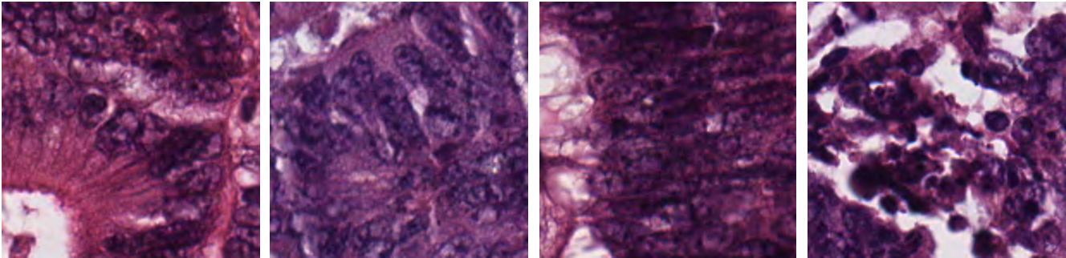
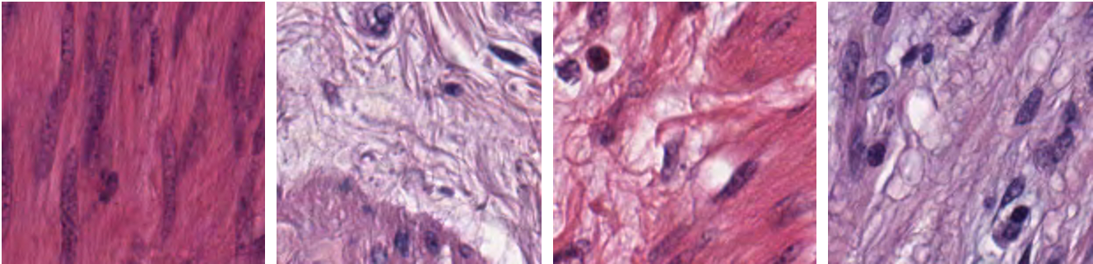
Introduction - Goal
Tumor
Stroma
The goal of this study is to train a classifier that can identify two categories of tissue (tumor and stroma) in colorectal cancer histological images.

Slide 5

Data
1250 histopathological images (150px x 150px) of primary colorectal tumors
625 tumor epithelium and 625 simple stroma tissue slides
Wide variation
Tissue texture
Stain intensity
Illumination
Kather J N, Weis C A, Bianconi F, et al. Multi-class texture analysis in colorectal cancer histology[J]. Scientific reports, 2016, 6: 27988.

Slide 6
Methodology - DCGAN
Deep Convolutional Generative Adversarial Networks (DCGAN)
DCGAN is a famous variant of generative adversarial networks in image identification
that integrates one generator and one discriminator
Fang W, et al. A method for improving CNN-based image recognition using DCGAN[J]. CMC: Comput. Mater. Continua, 2018, 57(1): 167-178.

Slide 7
Methodology - PCA
The number of PCA components were chosen by
examining the cumulative distribution of PCA eigenvalues.
After applying the PCA model to image dataset,
the original images were reconstructed through applying an inverse transform.
An example in hand-writing number

Slide 8
Methodology - Classification
Inception V3 is the 1st Runner Up for image classifier in ILSVRC (ImageNet Large Scale Visual Recognition Competition) 2015.
An example
Fang W, et al. A method for improving CNN-based image recognition using DCGAN[J]. CMC: Comput. Mater. Continua, 2018, 57(1): 167-178.

Slide 9
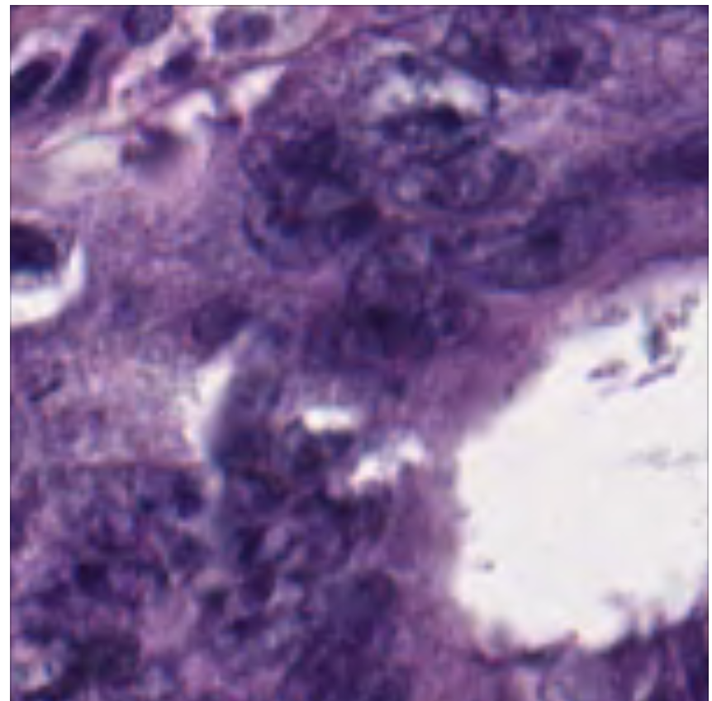
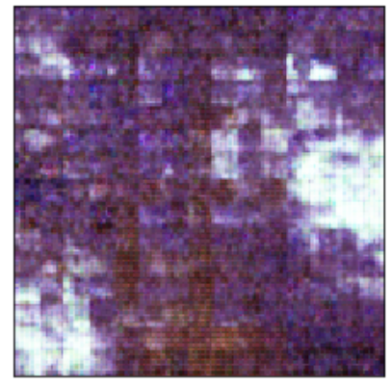
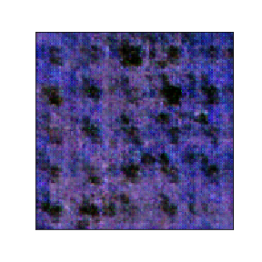
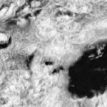
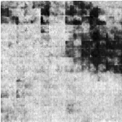
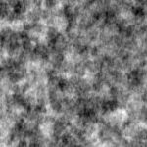
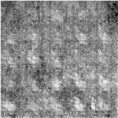
Results
Part1: Generative results of tumor or stroma samples
A
B
C
D
Unprocessed Tumor
Generative Tumor
Unprocessed Stroma
Generative Stroma
E
F
G
H
PCA-Reconstructed Tumor
PCA-Reconstructed
Generative Tumor
PCA-Reconstructed Stroma
PCA-Reconstructed
Generative Stroma
Fig.1. Example comparison of unprocessed images with generative images from DCGAN and PCA-reconstructed data

Slide 10
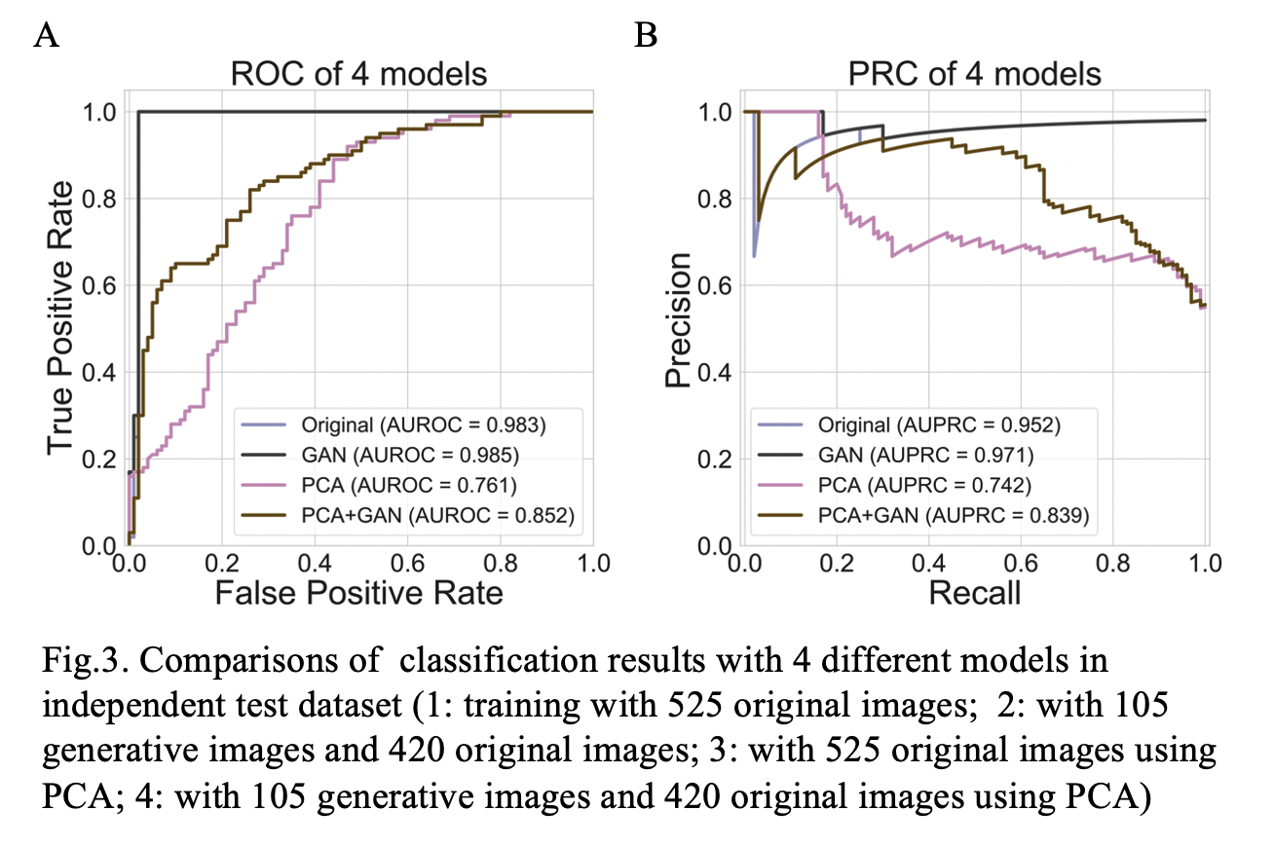
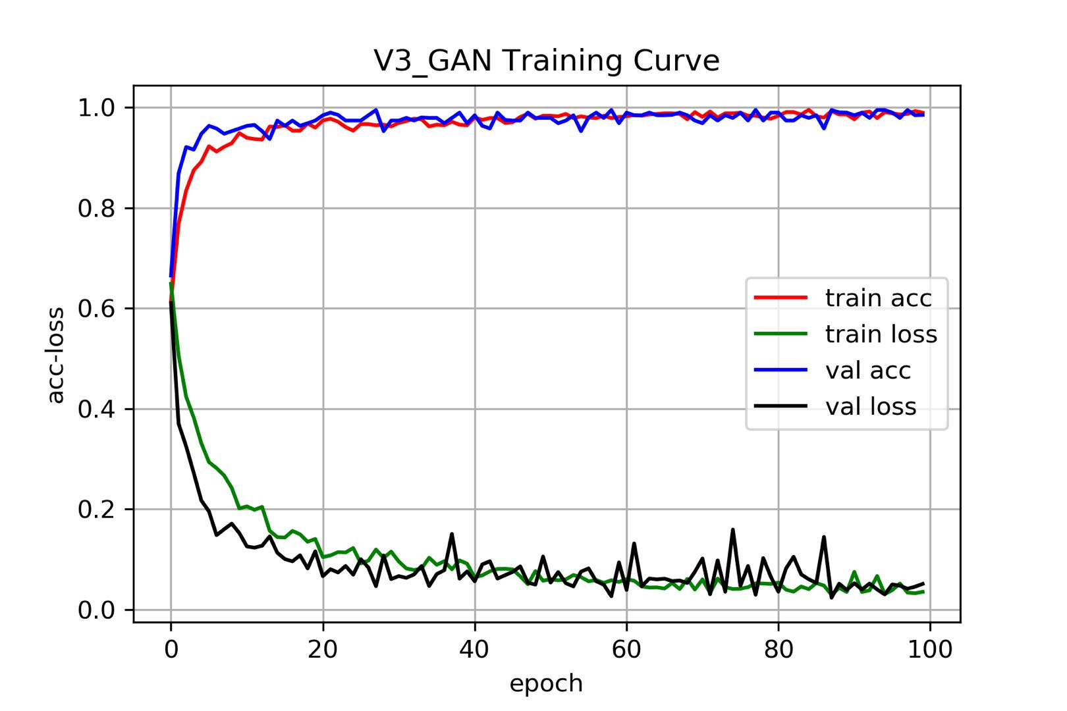
Results
Part 2. Classification results with deep learning

Slide 11
Conclusion
Tissue classification in
primary colorectal tumors
Original
DCGAN
DCGAN+PCA
PCA
DCGAN could help ‘enlarging’ the dataset
Good choice for small datasets i.e medical data
PCA-reconstructed data achieved relatively high accuracy despite using less information
Important features were retained
Future Works
Classification of multi-class data
Computational efficiency evaluation of PCA-reconstructed data

Slide 12
Thanks!

Slide 13
Q & A

